Slide 1

Health Spending, Life Expectancy, and GDP per Capita: A Comparative Analysis Between Europe and the US
View in Power BI
View in Excel
Notes:
This study investigates the interplay between health expenditure per capita, life expectancy, and GDP per capita across European countries and the United States, both in cross-sectional and longitudinal perspectives. It reveals significant disparities in levels, spending priorities, and health outcomes — particularly in the case of the United States.

Slide 2
Summary of Key Terms
PPP (Purchasing Power Parity): PPP stands for Purchasing Power Parity. It reflects how much a unit of currency can buy in terms of goods and services within a country. This adjustment allows for meaningful comparisons of income and expenditure across countries by accounting for differences in local price levels and cost of living.
EU15: The 15 countries in the European Union before the 2004 enlargement.
EU28: All EU countries prior to the UK leaving the EU.
EFTA: Non-EU countries in the European single market (Iceland, Norway, Switzerland).
Log (ln) scale: A logarithmic (natural log) scale is used to manage skewed distributions and visualize non-linear relationships. It helps highlight percentage changes rather than absolute differences, making patterns like diminishing returns or exponential growth easier to interpret.
Notes:
Country ISO
AUT → Austria, BEL → Belgium, BGR → Bulgaria, CHE → Switzerland, CYP → Cyprus, CZE → Czechia, DEU → Germany, DNK → Denmark, ESP → Spain, EST → Estonia, FIN → Finland, FRA → France, GBR → United Kingdom, GRC → Greece, HRV → Croatia, HUN → Hungary, IRL → Ireland, ISL → Iceland, ITA → Italy, LTU → Lithuania, LUX → Luxembourg, LVA → Latvia, NLD → Netherlands, NOR → Norway, POL → Poland, PRT → Portugal, ROU → Romania, SVK → Slovakia, SVN → Slovenia, SWE → Sweden, USA → United States

Slide 3
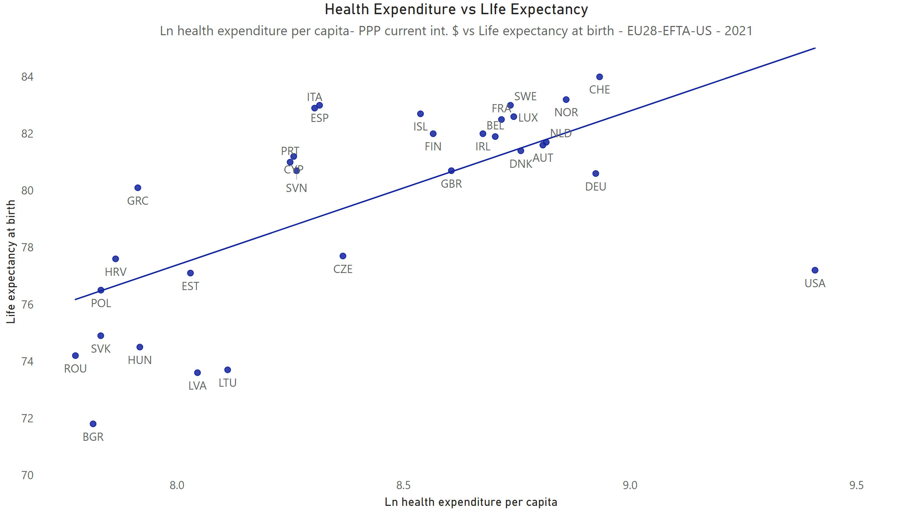
Health expenditure vs Life expectancy
Notes:
Correlation Between Health Expenditure per Capita and LIfe Expectancy
This scatter plot shows the relationship between the natural logarithm (ln) health expenditure per capita (PPP-adjusted) and life expectancy at birth across Europe and the US in 2021.
Finding
Despite much higher health spending, the US achieves lower life expectancy than peer countries of Western Europe. Most European countries cluster in a zone of moderate or high spending and high outcomes, suggesting that beyond a certain point, additional spending has limited effect on life expectancy.
Data
Pearson coefficient: 0,66 (Moderate positive relationship)
Simple Linear Regression: y = 5,4136x + 34,072; R² (coefficient of determination) = 0,43 (Moderate explanatory power)

Slide 4
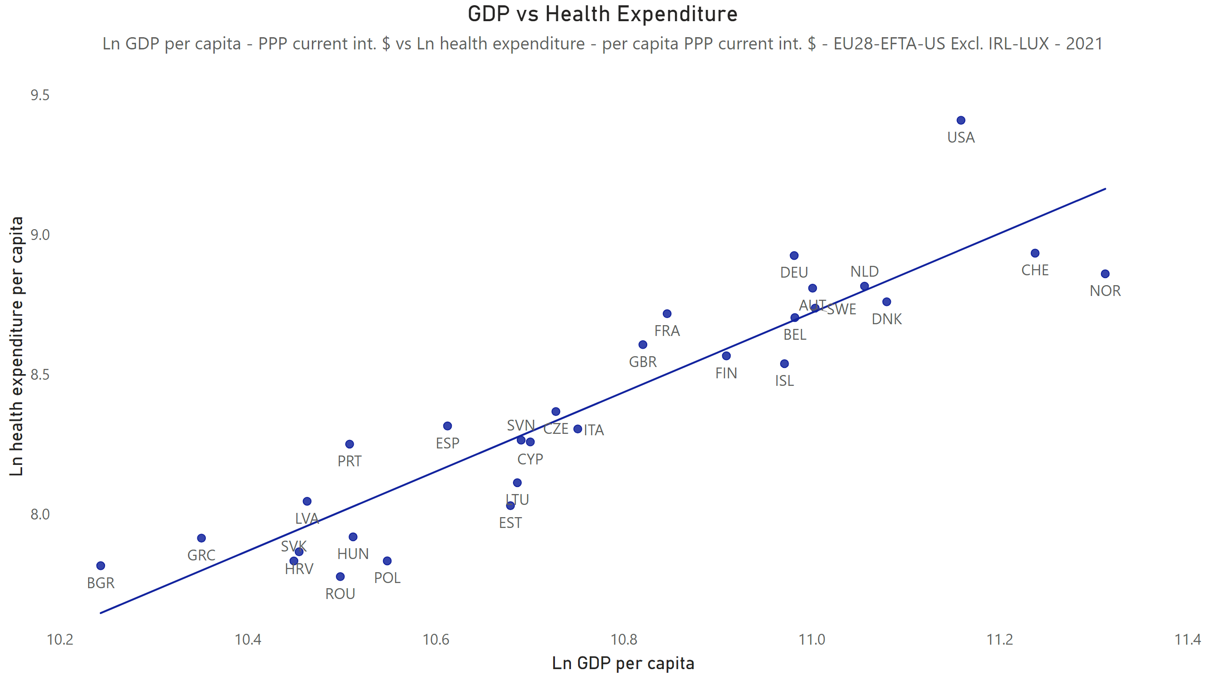
Health expenditure vs GDP per capita
Notes:
Correlation Between GDP per Capita and Health Expenditure per Capita
This graph plots the natural logarithm (ln) of GDP per capita (PPP) against the natural logarithm (ln) of health expenditure per capita (PPP) across Europe and the US in 2021 to explore how income levels relate to health spending.
Finding
There is a strong positive association between national income (or GDP) and health expenditure, but the US stands out as a clear outlier, spending significantly more than countries with similar or even higher per capita income.
Note
Ireland and Luxembourg are excluded from the comparison due to known statistical distorsions. In both Ireland and Luxembourg, GDP figures are significantly inflated by multinational corporate activities, profit shifting, and cross-border commuter workers. As a result, GDP per capita is not representative of domestic income or spending capacity. These countries are excluded from the analysis to ensure a more accurate and meaningful cross-country comparison.
Data
Pearson coefficient: 0,92 (Very strong positive relationship)
Simple Linear Regression: y = 1,4194x - 6,8936; R² (coefficient of determination)= 0,84 (Very strong explanatory power)

Slide 5
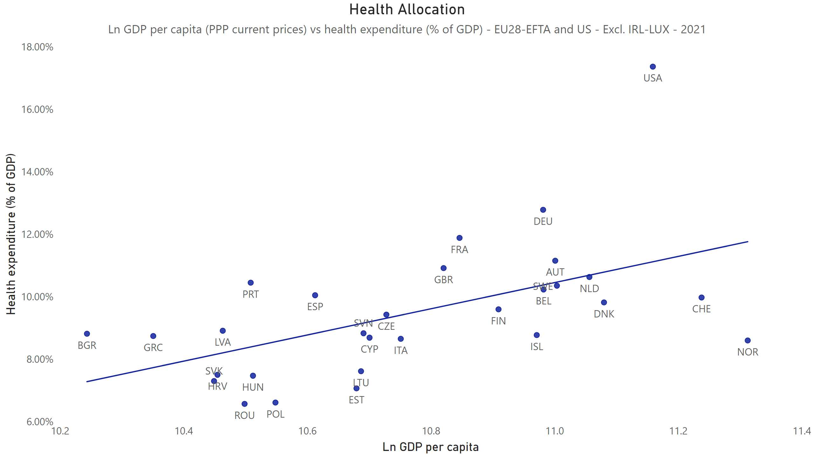
Health allocation
Notes:
Correlation Between GDP per Capita and Health Expenditure (% of GDP)
This plot shows the share of GDP allocated to health spending versus GDP per capita (PPP), using a log-linear relationship across Europe and US in 2021.
Finding
Not only the US spends the most in absolute terms, but also allocates a much higher share of its GDP to health than other high-income countries, raising concerns about efficiency. Although there is more dispersion than in the previous relationship (health spending per capita vs. GDP per capita), most European countries remain broadly aligned with expected values given their income levels.
Note
Ireland and Luxembourg are excluded from the comparison due to known statistical distorsions. In both Ireland and Luxembourg, GDP figures are significantly inflated by multinational corporate activities, profit shifting, and cross-border commuter workers. As a result, GDP per capita is not representative of domestic income or spending capacity. These countries are excluded from the analysis to ensure a more accurate and meaningful cross-country comparison.
Data
Pearson coefficient: 0,54 (Moderate positive relationship)
Simple Linear Regression: y = 0,0419x - 0,3566; R² (coefficient of determination)= 0,29 (Moderate explanatory power)

Slide 6
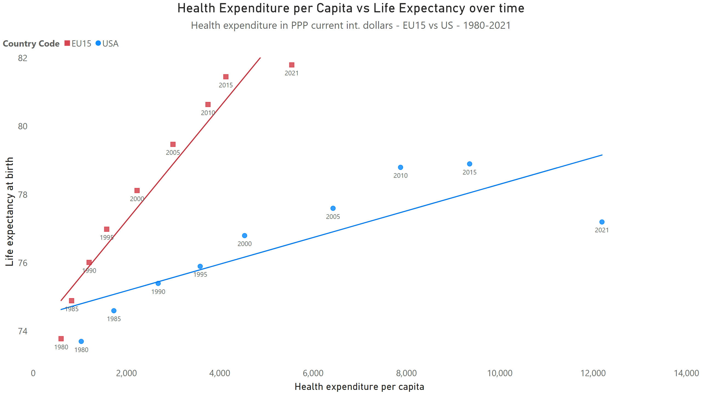
Health expenditure and Life expectancy over time
Notes:
Correlation Between Health Expenditure per Capita and Life Expectancy Over Time
This chart illustrates the evolution of the relationship between health expenditure per capita (in PPP international dollars) and life expectancy at birth for the US and EU15 countries from 1980 to 2021.
Finding
While both regions have increased their health spending over time, the EU15 has achieved greater improvements in life expectancy at significantly lower expenditure levels. This growing divergence highlights structural efficiency issues in the US healthcare system—particularly after 2000—especially considering that in 1980, the US and Western Europe started from comparable levels of both health spending and life expectancy.
Data
Pearson coefficient EU15: 0,96 (Very strong positive relationship)
Pearson coefficient US: 0,82 (Strong positive relationship)
Simple Linear Regression EU15: y = 0,0017x + 73,893; R² = 0,93 (Very strong explanatory power)
Simple Linear Regression US: y = 0,0004x + 74,4; R² (coefficient of determination)= 0,67 (Strong explanatory power)

Slide 7
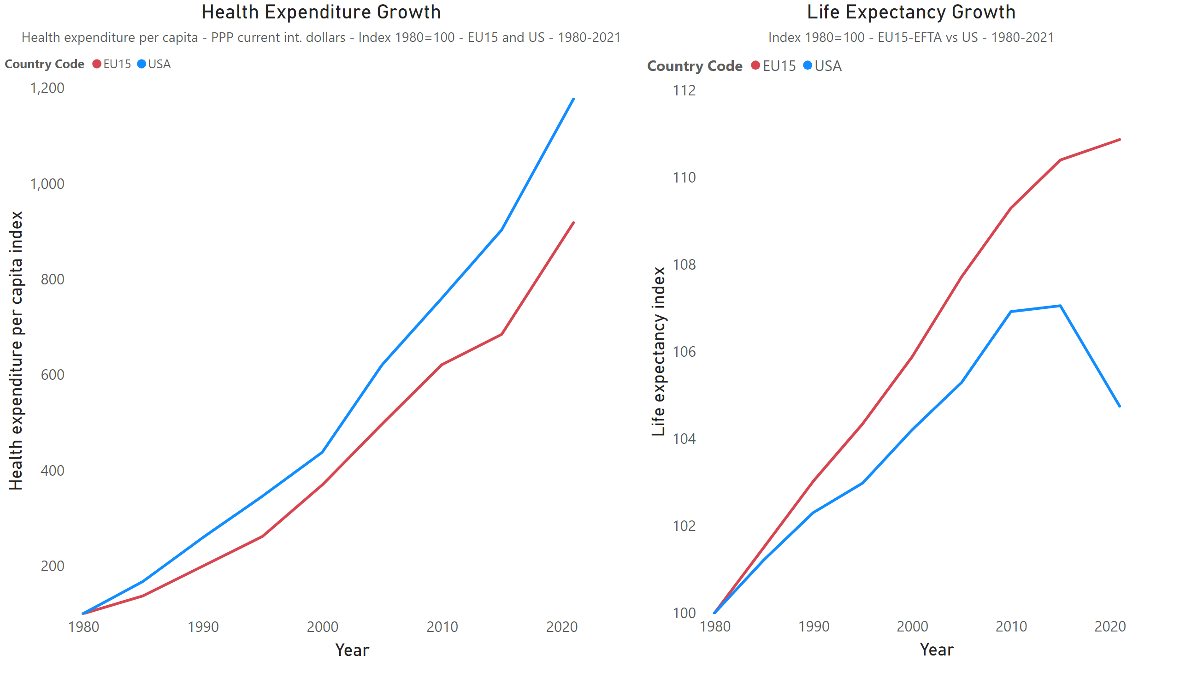
Indexes
Notes:
Cumulative Growth in Health Expenditure per Capita and Life Expectancy
This chart compares the indexed cumulative growth of health expenditure per capita (in PPP international dollars) and life expectancy at birth in the US and EU15 countries from 1980 to 2021. Index = 100 in 1980.
Finding
While both regions have significantly increased their health spending, the EU15 has achieved greater gains in life expectancy with lower cumulative expenditure. The growing divergence, especially after 2000, raises concerns about the cost-effectiveness and efficiency of the US healthcare system.

Slide 8
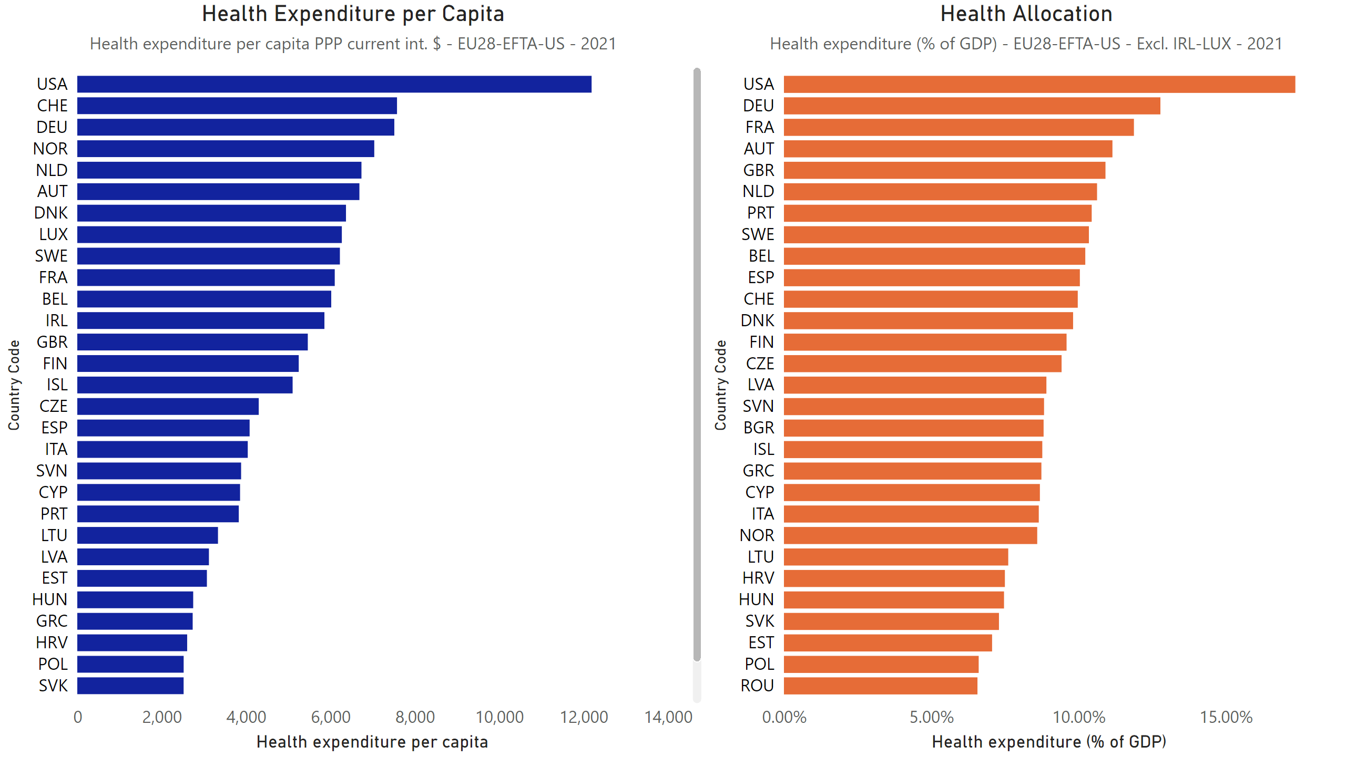
Health Expenditure per capita
Notes:
Health Expenditure per Capita and Health allocation
Left chart ranks countries by health expenditure per capita (PPP); the right ranks them by health spending as a share of GDP across Europe and US in 2021.
Finding
On the left, health expenditure per capita (PPP) shows the absolute level of spending per person. The United States stands out dramatically, spending far more than any other country—more than 50% higher than Switzerland, the second-highest spender. On the right, health expenditure as a percentage of GDP reflects the relative effort or priority given to health in each economy. Again, the US leads by a wide margin, allocating over 17% of its GDP to health—well above the European average. This double outlier position—both in absolute and relative terms—raises important questions about efficiency, sustainability, and health system performance in the United States.
Note
Ireland and Luxembourg are excluded from the comparison due to known statistical distorsions. In both Ireland and Luxembourg, GDP figures are significantly inflated by multinational corporate activities, profit shifting, and cross-border commuter workers. As a result, GDP per capita is not representative of domestic income or spending capacity. These countries are excluded from the analysis to ensure a more accurate and meaningful cross-country comparison.

